Slide 1
Description and Contribution
- Sleep Apnea
- Testing in Children
- At-home Viability
- ECG and SpO2
- Transformer-based model

Slide 2
Training
-Hyperparameters:
Learning rate – 0.001
Batch size – 256
Dropout rate – 0.25
-Computational Requirements:
Num. Of training epochs: 100
Avg. runtime for each epoch: 15 minutes
Suggested RAM – minimum 16GB
-Loss function:
Binary cross entropy
BCE(y, ŷ) = -[y·log(ŷ) + (1-y)·log(1-ŷ)]

Slide 3
Evaluation Metrics
- F1 Score
- Area Under Curve Score
- Accuracy
- Precision
- Recall
- Specificity

Slide 4
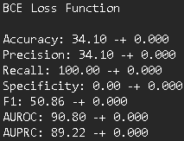
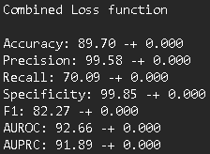
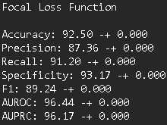
Additional Extension
- Focal Loss
- Combined Focal Loss and BCE Loss

Slide 5
Implication of Results
- ECG & SpO2
- Accessibility of testing
- Transformer-based model
- Multi-modal approach
- Flexibility with noise and signal quality

Slide 6
Recommendations for Reproduction
- Detailed setup instruction
- Anonymized sample data
- Subgroup testing
- Reproducibility in different environments

